Slide 1


Naor Alaluf
21/12/2022

Slide 2

Outline
Executive Summary
Introduction
Methodology
Results
Conclusion
Appendix

Slide 3
Executive Summary
Summary of methodologies
Summary of all results

Slide 4
Introduction
The success of SpaceX inspired the creation of SpaceY, a competitor in the field of sending rockets to space.
Most of the work of the Falcon 9 rocket, that is designed to send a payload to space is done by the first stage, which later detaches from the rocket.
If possible, an attempt to land the first stage is made.
Given information about a future launch, we would like to predict whether the first stage will land successfully, or crash.

Slide 5

Section 1

Slide 6
Methodology
Executive Summary
Data collection methodology:
We use the public SpaceX REST API, as well as data scraping from the SpaceX Wikipedia page.
Perform data wrangling
Categorical columns are converted to one-hot vectors.
A ‘Class’ label is created from the ‘Landing Outcome’ column.
Perform exploratory data analysis (EDA) using visualization and SQL
Perform interactive visual analytics using Folium and Plotly Dash

Slide 7
Methodology
Executive Summary
Perform predictive analysis using classification models
Tuning Logistic Regression, Decision Tree, SVM and KNN machines using Grid Search on a training portion of the data.
Evaluating the accuracy of the models on the test set and view the confusion matrix.

Slide 8
Data Collection
The datasets were collected using two methods:
GET Requests to the SpaceX APIs
Web scraping using an archive version of a Wikipedia page.

Slide 9
Data Collection – SpaceX API
Using the command response = requests.get(url) for each URL address.
Extracting the desired attributes from the JSON object.
Constructing a DataFrame from the fetched data.
See detailed notebook in GitHub.

Slide 10
Data Collection - Scraping
Using the command response = requests.get(url) with the Wikipedia URL.
Creating a BeautifulSoup object containing the webpage contents.
Using the soup to find tables (<table>), headers (<th>) and rows (<tr>) objects.
Collecting the data from the rows of the tables.
See detailed notebook in GitHub.

Slide 11
Data Wrangling
Preprocessing outcomes:
Creating a ‘Class’ column, mapping each bad outcome to ‘0’ and each good outcome to ‘1’.
Handling categorical columns:
Converting categorical columns into one-hot vectors (dummies).
Handling missing data:
Replacing NaN values in the PayloadMass column with the mean of the column.
Making the data frame suitable for learning:
Casting all numerical and Boolean values to type ‘float64’.
See more details in the Data Collection lab, in the Data Wrangling lab and in the Data Visualization lab.

Slide 12
Data Wrangling

Slide 13
EDA with Data Visualization
Scatter plot of Flight Number vs. Launch Site, using Class as hue.
We can observe the success rates of landing the first stage in each of the sites, and how they change over time.
Scatter plot of Payload Mass vs. Launch Site, using Class as hue.
Helps up see how the weight of the payload mass affected the success rate in each of the sites, as well as the range of masses in each launch site.
Bar plot of Orbit vs. Success Rate.
Checking for a relationship between the orbit type and the probability of success.
Scatter plot of Flight Number vs. Orbit, using Class as hue.
Observe the changes in the orbit type used over time, and the affect on the success rate.

Slide 14
EDA with Data Visualization
Scatter plot of Payload Mass vs. Orbit, using Class as hue.
Revealing which payload masses were carried on each orbit, and the affects on success.
Line plot of Year vs. Success Rate.
Getting a visualization of the yearly trend of success rates.
See the complete code in GitHub.

Slide 15
EDA with SQL
SQL Queries:
Unique launch sites.
5 records where launch sites begin with the string 'CCA’.
The total payload mass carried by boosters launched by NASA (CRS).
Average payload mass carried by booster version F9 v1.1.
Date of the first successful landing.
The names of the boosters which have success in drone ship and have payload mass between 4000 and 6000.

Slide 16
EDA with SQL
More SQL Queries:
The total number of successful and failure mission outcomes.
The names of the booster versions which have carried the maximum payload mass.
The records which will display the month names, failure landing outcomes in drone ship, booster versions and launch site for the months in year 2015.
The count of successful landing outcomes between the date 04-06-2010 and 20-03-2017 in descending order.
See the complete code in GitHub.

Slide 17
Build an Interactive Map with Folium
The maps helps us visualize the surroundings of the launching sites, along with the success rates.
For every launch site, we draw the following objects.
A circle and a label to identify the launch site.
A marker cluster of green markers for successful landings and red markers for failures, allows us to visualize the success rate.
For a chosen site, we also draw a line to the nearest coastline, highway, railway and town, to get additional data to describe and differentiate launch sites.
See the complete code in GitHub.

Slide 18
Build a Dashboard with Plotly Dash
For all sites:
Pie chart of successful landings per launch site.
Helps us answer which site had the highest/lowest success rate.
Scatter plot of Payload Mass vs. Class, colored by the Booster Version Category, within a selected range of payload masses.
Gives us insights on the success rates for different payload ranges and booster versions.

Slide 19
Build a Dashboard with Plotly Dash
For a selected site:
Pie chart of the success rate in the selected site.
Successful landings vs. failures.
Scatter plot of Payload Mass vs. Class, colored by the Booster Version Category, within a selected range of payload masses.
Gives us more information about which booster versions were used in a selected site, the payload ranges used in each site and the success rates.
See the completed code in GitHub.

Slide 20
Predictive Analysis (Classification)
Predicting the column ‘Class’ using various classifiers.
Logistic Regression, Support Vector Machine, Decision Tree and K-Nearest Neighbors.
Splitting the data into a train set and a test set.
Using Grid Search on the training set to find the best hyperparameters for each model.
Evaluating the accuracies of the classifiers using the Grid Search object and the test set.

Slide 21
Results - Exploratory data analysis
The graphs we generated revealed a lot of information. To list a few:
The first launches were done from CCSFS with a poor success rate. In this period, there were 2 landing failures for launches from VAFB and no launches from KSC.
After the 25th~ launch, the success rates in all sites increased.
The rockets launched from VAFB were carrying less than 10 tons of payload.
A 100% success rate was reported for the orbits ES-L1, GEO, HEO and SSO, while SO had 100% of failures.
We take into consideration that ES-L1, HEO, GEO and SO each only had 1 launch in the dataset.
Rockets with over 9 tons of payload successfully landed mostly when the planned orbit was ISS , PO and VLEO.
The overall success rates increases yearly.

Slide 22
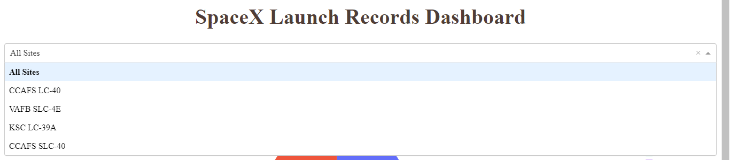
Results - Interactive analytics
Dashboard demo:
First we choose “All Sites” or a particular site from the list.

Slide 23
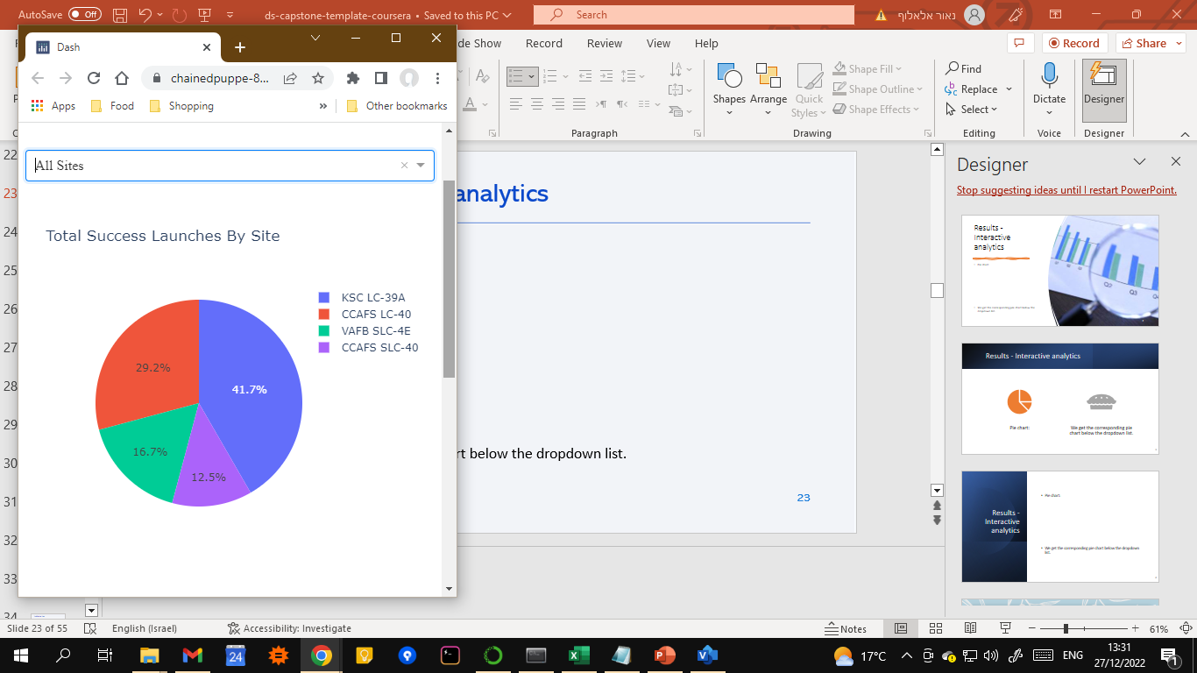
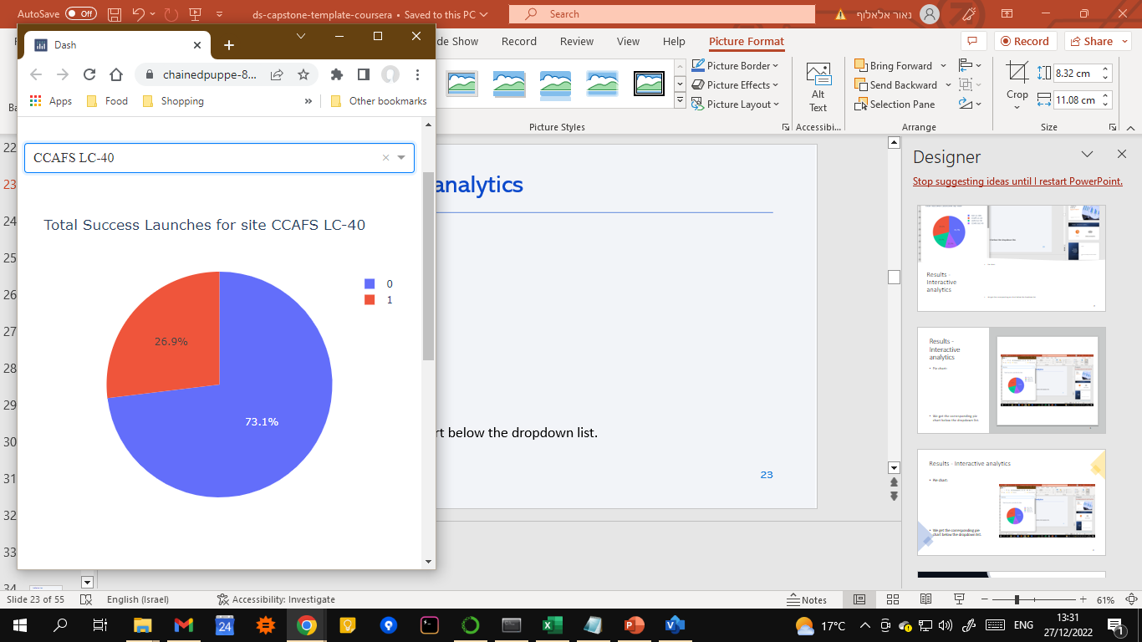
Results - Interactive analytics
Pie chart:
We get the corresponding pie chart below the dropdown list.

Slide 24
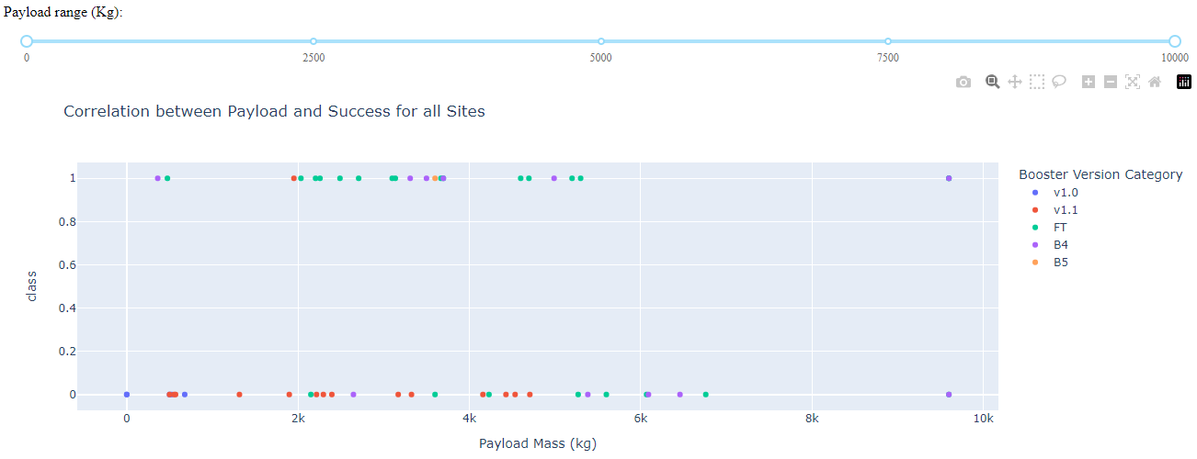
Results - Interactive analytics
Additionally, we get a corresponding scatter plot:

Slide 25

Results - Interactive analytics
Where we can use the slider to choose a range for the Payload Mass.

Slide 26
Results - Predictive analysis
The best results were achieved by the K-Nearest Neighbors classifier, with 88.89% accuracy on the test set.
The main problem with mislabeled examples is false positives.
Remark: Note that the data imported in the lab yielded classifiers of equal accuracies on the test set, but in the final notebook I used a different value for “random_state” and achieved different results.

Slide 27

Section 2

Slide 28
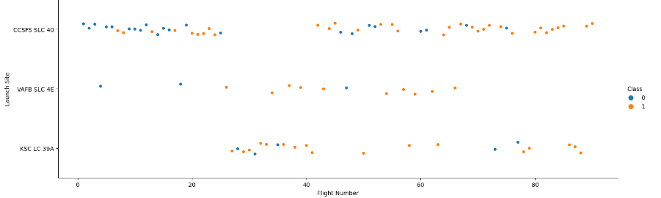
Flight Number vs. Launch Site
We can see the success rate improving over time, mostly in the first two sites.
CCSFS was the first site to host a launch and it hosted most of the launces.

Slide 29
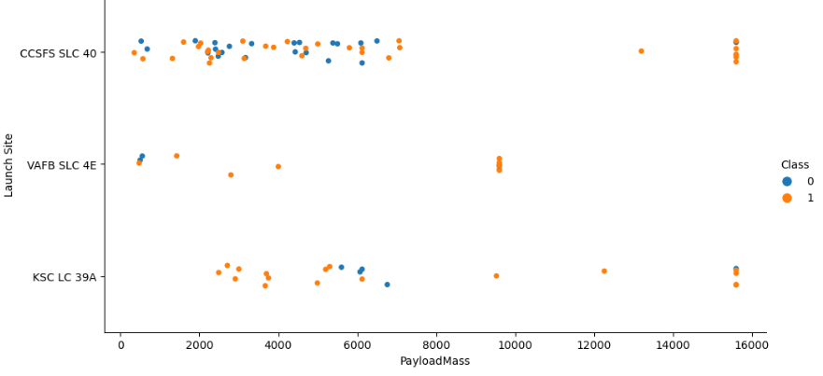
Payload vs. Launch Site
VAFB did not launch payloads heavier than 10 tons.
Heavy payloads have a decent success rate.

Slide 30
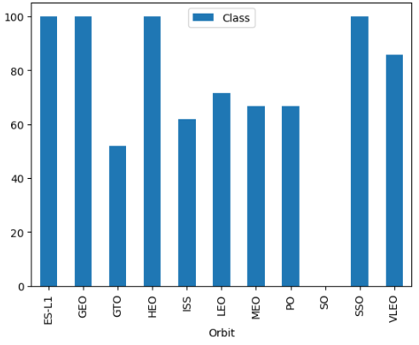
Success Rate vs. Orbit Type
The y-axis represents the percentage of success of each orbit type.
Mostly, the success rate is quiet low (50%-60%). We note that the EDA process also revealed that the very high/low success rates were not calculated on a lot of examples, and therefore don’t necessarily indicate a future success/failure.

Slide 31
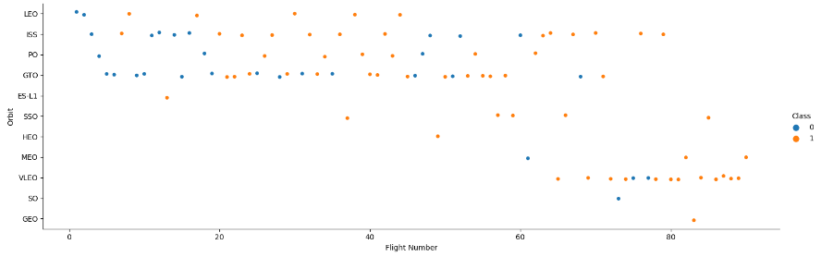
Flight Number vs. Orbit Type
The insights from the previous slide are shown more clearly in this scatter plot.
We can observe that approximately half of the orbit types appear in the later half of the flights, with high success rate.

Slide 32
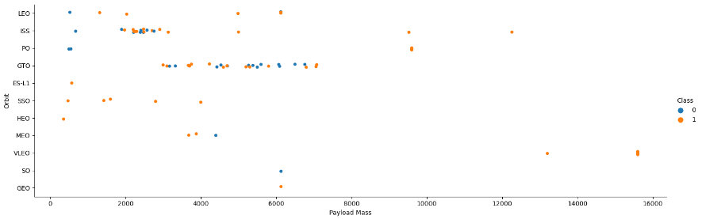
Payload vs. Orbit Type
Rockets with over 9 tons of payload were sent to orbit types ISS, PO and VLEO.
Those rockets had success rate of 100%.

Slide 33
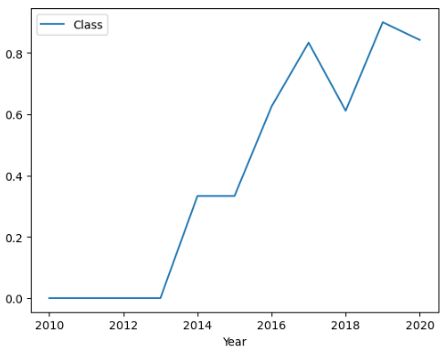
Launch Success Yearly Trend
A yearly trend of increase in the overall success rate.

Slide 34
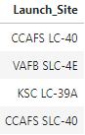
All Launch Site Names
SELECT DISTINCT("Launch_Site") FROM SPACEXTBL;
The DISTINCT function takes the input column without any duplicates.

Slide 35
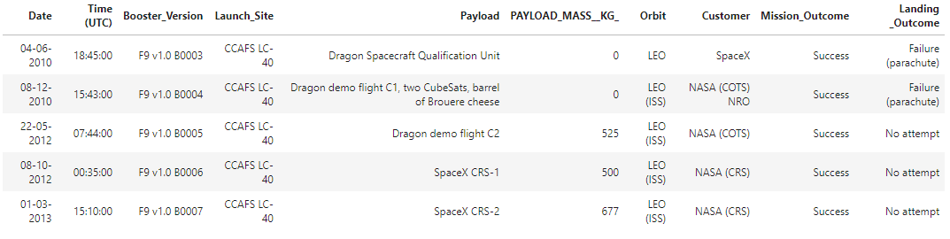
Launch Site Names Begin with 'CCA'
SELECT * FROM SPACEXTBL WHERE "Launch_Site" LIKE 'CCA%’ LIMIT 5;
The WHERE word filters the rows by a condition. LIKE sets a Boolean condition according to a string pattern. LIMIT limits the returned results by number first rows.

Slide 36
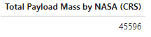
Total Payload Mass
SELECT SUM("PAYLOAD_MASS__KG_") AS "Total Payload Mass by NASA (CRS)" FROM SPACEXTBL WHERE "Customer"='NASA (CRS)’;
The SUM function returns the sum of a given column. The keyword AS gives this column a custom name. We filter the rows using the WHERE clause.

Slide 37
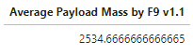
Average Payload Mass by F9 v1.1
SELECT AVG("PAYLOAD_MASS__KG_") AS "Average Payload Mass by F9 v1.1"
FROM SPACEXTBL
WHERE "Booster_Version" LIKE 'F9 v1.1%’
The AVG function calculates the mean of the column.
We filter the rows using the WHERE clause with the LIKE keyword.

Slide 38
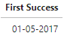
First Successful Ground Landing Date
SELECT MIN(Date) AS "First Success" FROM SPACEXTBL
WHERE "Landing _Outcome" LIKE 'Success%’;
The MIN function returns the minimum (first) date.
We take this minimum value only from rows that represent successful landings.

Slide 39
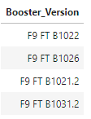
Successful Drone Ship Landing with Payload between 4000 and 6000
SELECT DISTINCT("Booster_Version") FROM SPACEXTBL
WHERE "Landing _Outcome" = 'Success (drone ship)’
AND "PAYLOAD_MASS__KG_" BETWEEN 4000 AND 6000;
We use AND to take rows that agree with more than one condition:
The outcome is a specific type of success (drone ship).
The payload mass is within a range: using the BETWEEN keyword.

Slide 40
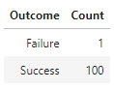
Total Number of Successful and Failure Mission Outcomes
SELECT SUBSTR("Mission_Outcome",1,7) AS "Outcome", COUNT("Mission_Outcome") AS "Count“
FROM SPACEXTBL GROUP BY SUBSTR("Mission_Outcome",1,7);
Using the SUBSTR function lets us display “Success” and “Failure” (which both happen to have 7 characters), instead of differentiating between different types of success.
We use the COUNT function to get the number of rows in each group, when the groups are divided by the first 7 letters of the outcome.

Slide 41
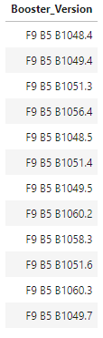
Boosters Carried Maximum Payload
SELECT DISTINCT("Booster_Version") FROM SPACEXTBL
WHERE "PAYLOAD_MASS__KG_" =
(SELECT MAX("PAYLOAD_MASS__KG_") FROM SPACEXTBL);
The subquery gets the maximum payload mass, and we use that value when conditioning on the rows in the outer query.

Slide 42
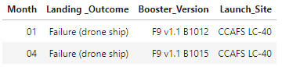
2015 Launch Records
SELECT SUBSTR("Date",4,2) AS "Month", "Landing _Outcome",
"Booster_Version", "Launch_Site“ FROM SPACEXTBL
WHERE SUBSTR("Date",7,4) = '2015’ AND
"Landing _Outcome" = "Failure (drone ship)";
We get the month and year from the date by using the SUBSTR function.
We take only rows where the year equals to 2015 and the outcome is a failure (drone ship).

Slide 43
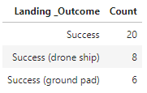
Rank Landing Outcomes Between 2010-06-04 and 2017-03-20
SELECT "Landing _Outcome", COUNT("Landing _Outcome") AS "Count"
FROM SPACEXTBL
WHERE "Landing _Outcome" LIKE 'Success%’ AND
"Date" BETWEEN '04-06-2010’ AND '20-03-2017’
GROUP BY "Landing _Outcome"
ORDER BY COUNT("Landing _Outcome") DESC;
We take the rows of successful landings in the desired range using LIKE and BETWEEN in the WHERE clause.
We group these rows by the type of success, counting the number of rows in each group, and ordering the results in descending order.

Slide 44

Section 3

Slide 45
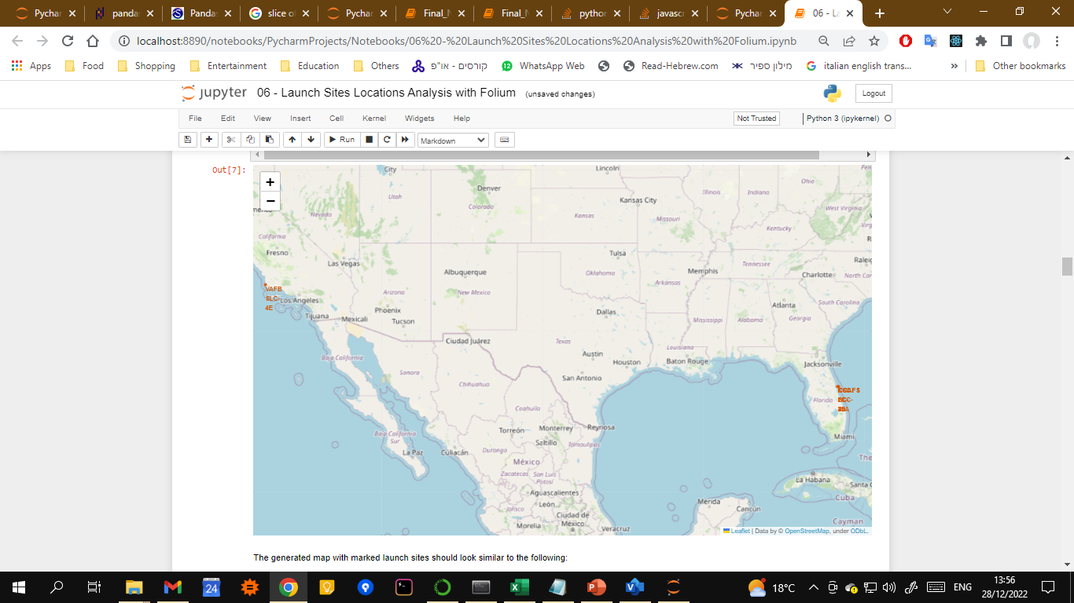
Launch Sites Locations on a Folium Map
A circle is drawn around the coordinates of each launch site, along with a label.

Slide 46
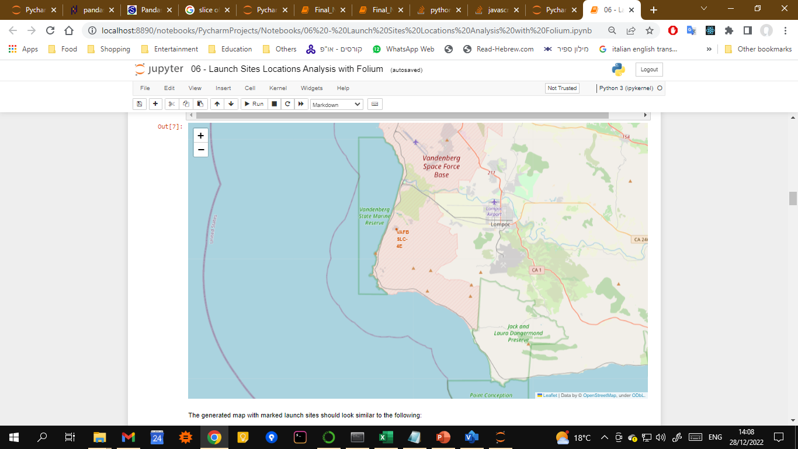
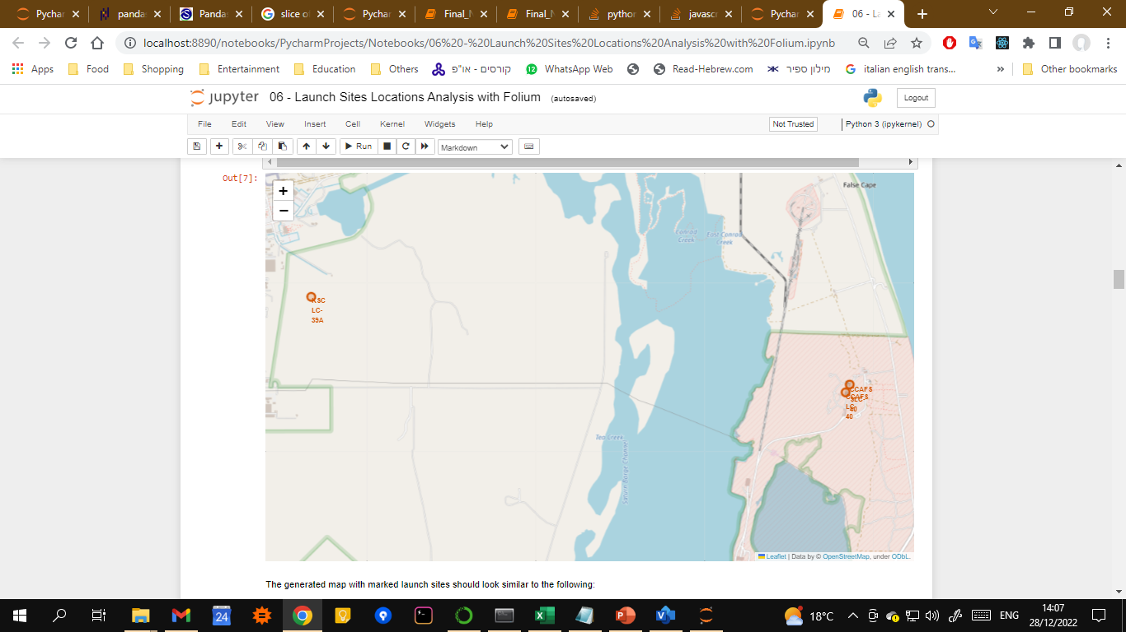
Launch Sites Locations on a Folium Map
There is one site on the west coast, and 3 sites on the east coast.

Slide 47
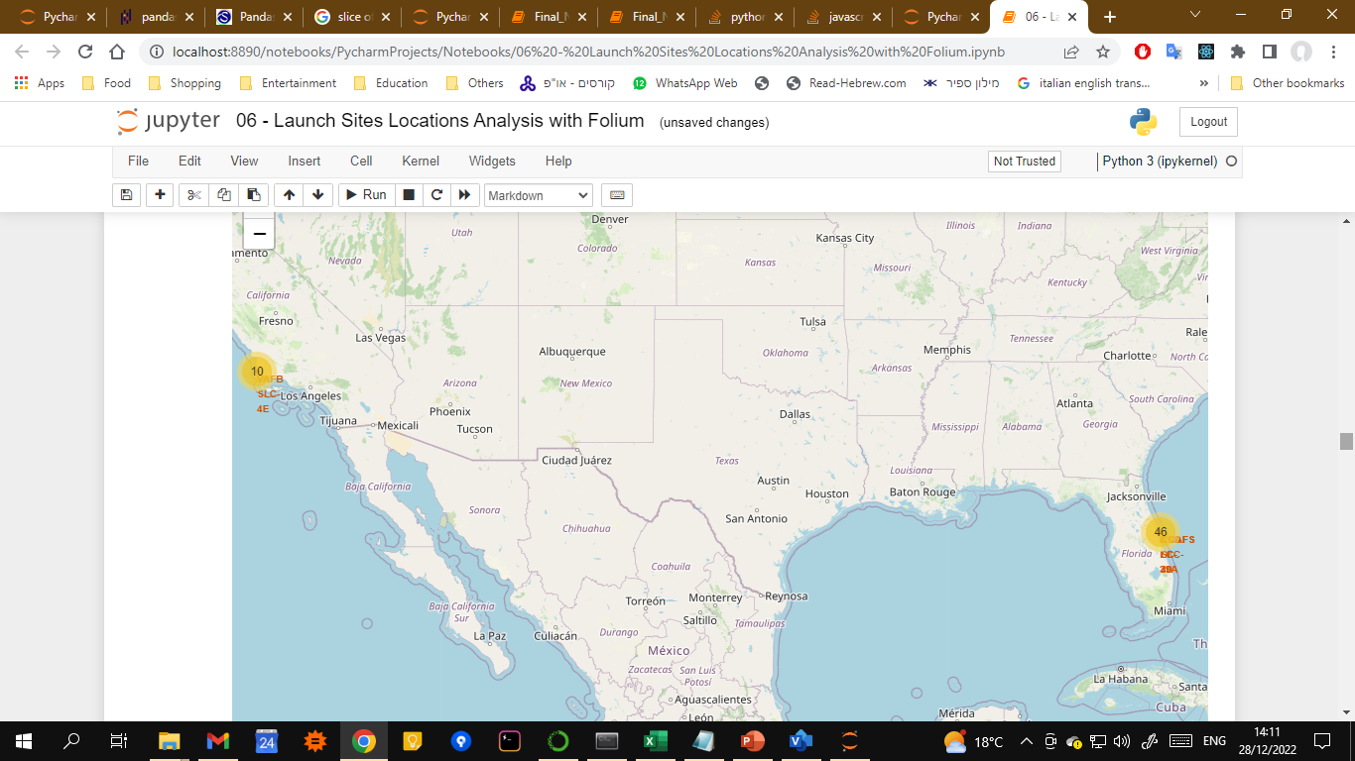
Launch Outcomes on a Folium Map
Using a marker cluster, we mark the launches on each site, and color them according to the outcome.

Slide 48
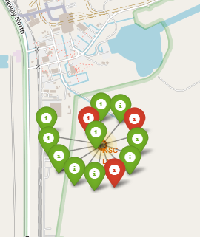
Launch Outcomes on a Folium Map
For example, when zooming in and clicking KSC LC-39A, we see that 3 out of 13 launches failed, which implies a success rate of approximately 77% in this site.

Slide 49
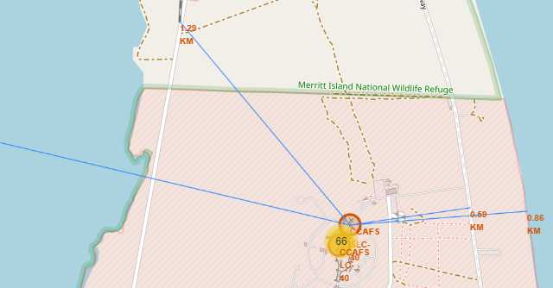
CCAFS SLC-40 Proximities on a Folium Map
The closest coastline is 0.86km away from the site.
The closest highway is 0.59km away from the site.
The closest railway is 1.29km away from the site.

Slide 50
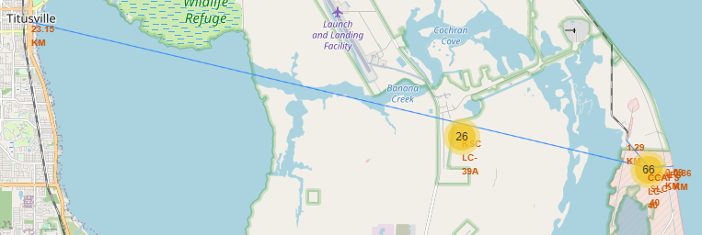
CCAFS SLC-40 Proximities on a Folium Map
The closest town is Titusville, and it is located 23.15km away from the site.

Slide 51

Section 4

Slide 52
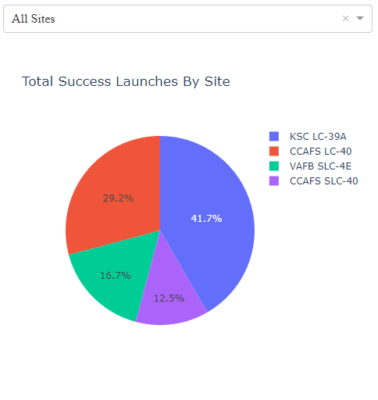
Dashboard: Success Count for All Sites
Selecting “All Sites” gives us a pie chart of the success counts in each launch site.
The launch site in which the highest number of successful landings has been reported was KSC LC-39A, with 41.7% of the overall successful landings.
The lowest number of successful landings is from CCAFS SLC-40 with only 12.5% of the overall count.

Slide 53
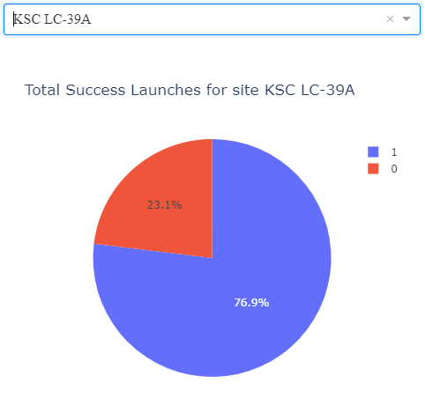
Dashboard: KSC LC-39A Success Ratio Pie chart
The largest success ratio was found for the site KSC LC-39A, with 76.9% rate of success.

Slide 54
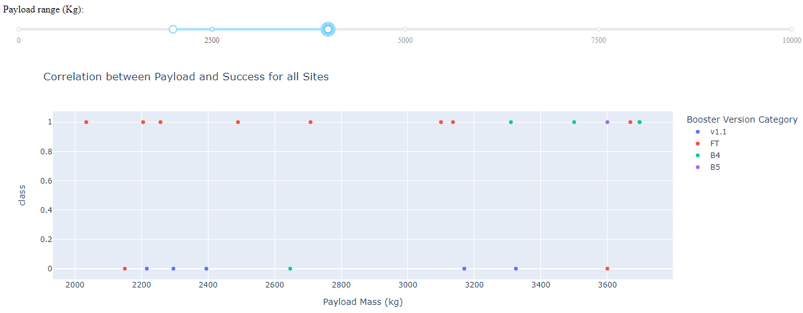
Dashboard: Payload vs. Launch Outcome
Observe the successful and failed outcomes for launches with payload mass in the range 2000 to 4000.

Slide 55
Dashboard: Payload vs. Launch Outcome
The overall success rate in this range is 60%. The FT’s score in this range is 80%, while v1.1 fails to land in 100% of the launches.

Slide 56

Section 5

Slide 57
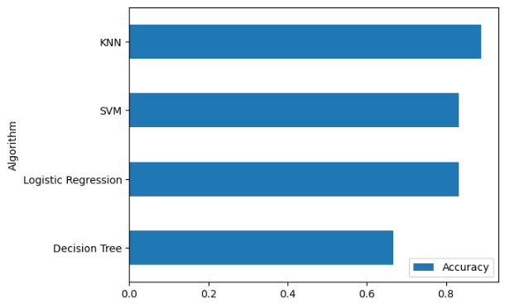
Classification Accuracy
The model with the highest accuracy of 88.89% is K-Nearest Neighbors.
(see the remark in Slide 26)

Slide 58
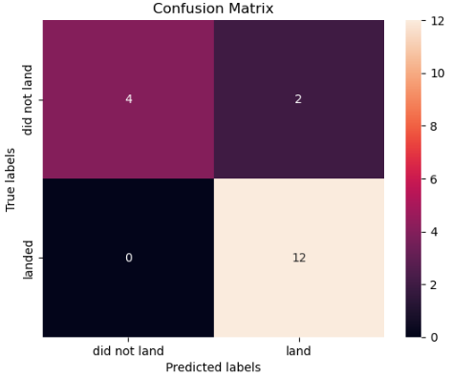
Confusion Matrix
We can see that there are no false negatives, and that the main problem with mislabeled examples is false positives.

Slide 59
Conclusions
The SpaceX data indicates an overall improvement in their ability to successfully land the first stage.
Since their first success in May 1st 2017, most of their success was reported for launches from KSC LC-39A (if we look at the CCAFS compound as two separate sites).
The heaviest payloads were sent to 3 out of the 11 orbit types, and they landed succesfully.
Booster version FT had high success ratio of 80% with payload masses between 2-4 tons.

Slide 60
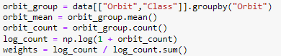
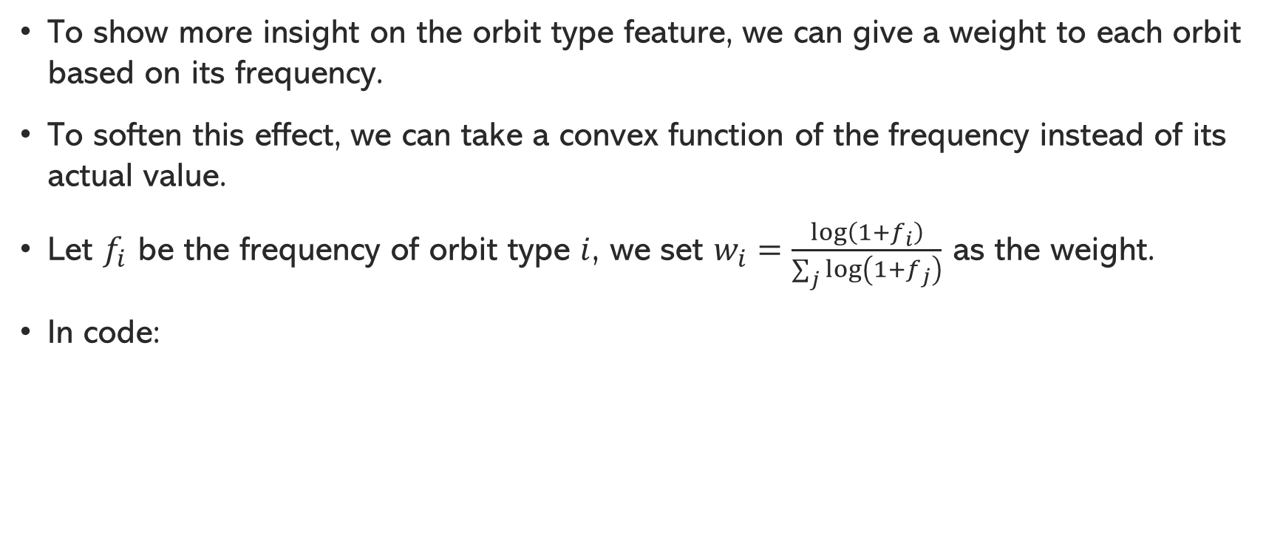
Appendix
To show more insight on the orbit type feature, we can give a weight to each orbit based on its frequency.
To soften this effect, we can take a convex function of the frequency instead of its actual value.
Let $f_{i}$ be the frequency of orbit type $i$, we set $w_{i}=\frac{\log\left(1+f_{i}\right)}{\sum_{j}{\log\left(1+f_{j}\right)}}$ as the weight.
In code:

Slide 61
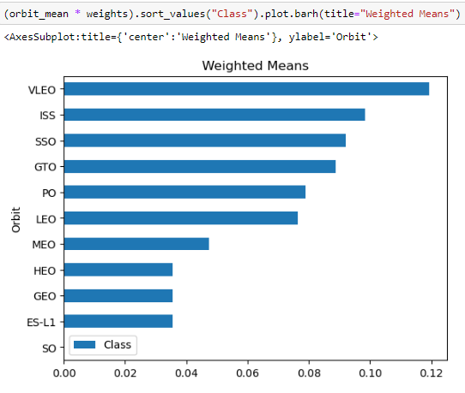
Appendix
We then can get a different picture in the following pie chart.
The lengths of the HEO, GEO and ES-L1 bars dropped dramatically to better reflect their impact.
In addition, the ranks of GTO and ISS rose dramatically.

Slide 62


